Slide 1
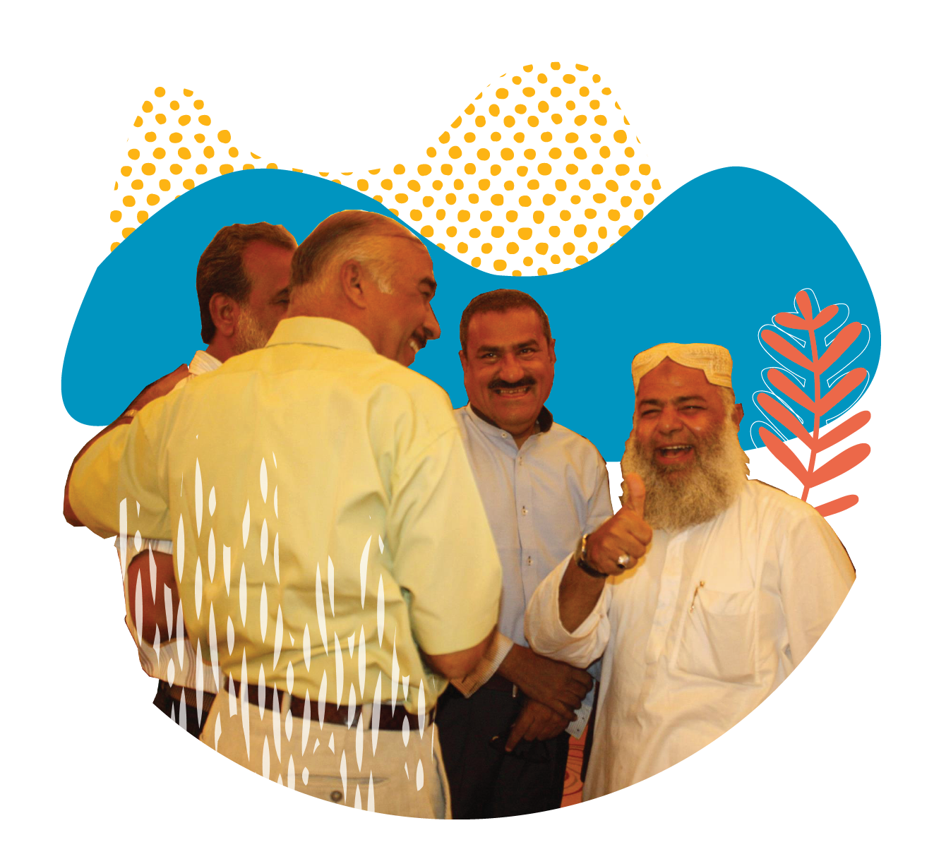
MODULE 9:
FREEDOM OF RELIGION OR BELIEF (FoRB)

Slide 2
What is FoRB?
“1. Everyone shall have the right to freedom of thought, conscience and religion. This right shall include freedom to have or to adopt a religion or belief of his choice, and freedom, either individually or in community with others and in public or private, to manifest his religion or belief in worship, observance, practice and teaching.
2. No one shall be subject to coercion which would impair his freedom to have or to adopt a religion or belief of his choice.
3. Freedom to manifest one's religion or beliefs may be subject only to such limitations as are prescribed by law and are necessary to protect public safety, order, health, or morals or the fundamental rights and freedoms of others.
4. The States Parties to the present Covenant undertake to have respect for the liberty of parents and, when applicable, legal guardians to ensure the religious and moral education of their children in conformity with their own convictions.”
(International Covenant on Civil and Political Rights, Article 18) 1966/1976
Notes:
https://www.equalrightstrust.org/ertdocumentbank/general%20comment%2022.pdf
General Comment - Committee’s Interpretation of the content of human rights provisions on thematic issues
Issued as individual documents
OHCHR - Office of the High Commissioner for Human Rights (UN Human Rights)
173 parties to the ICCPR
UNDHR is not legially binding, all 193 member states have ratified at least one of the 9 binding treaties that grew out of the declaration
At least 90 constitutions drafted since 1948 contain statements about human rights that are either inspired, or directly reproduced from UNDHR https://cdn2.sph.harvard.edu/wp-content/uploads/sites/125/2014/04/16-Hannum.pdf

Slide 3
What is FoRB?
What aspects of FoRB does this document protect?
Are there limits to FoRB?

Slide 4
What are the main constraints to FoRB in your country?

Slide 5
Legal constraints to FoRB - an example
Apostasy: an act of refusing to continue to follow, obey, or recognize a religious faith
Example: Saudi Arabia: Ashraf Fayadh given death sentence (commuted to lashes and imprisonment) for poetry that allegedly promoted atheism
Blasphemy: the act of insulting or showing contempt or lack of reverence for God
Example: Poland: Nergal, the frontman of the extreme metal band, ‘Behemoth’ was convicted of blasphemy after posting a photo online of him stepping on an image of the Virgin Mary
Notes:
https://www.theguardian.com/world/2016/feb/02/palestinian-poet-ashraf-fayadhs-death-sentence-overturned-by-saudi-court
https://www.theguardian.com/music/2021/mar/18/nergal-the-extreme-metal-musician-fighting-poland-blasphemy-laws
FoRB – new for many in Search, legal concept within human rights framework, not just interreligious dialogue etc. In addition to FoRB as a legal, human rights concept - there are a few legal concepts that are worth knowing within this framework.

Slide 6
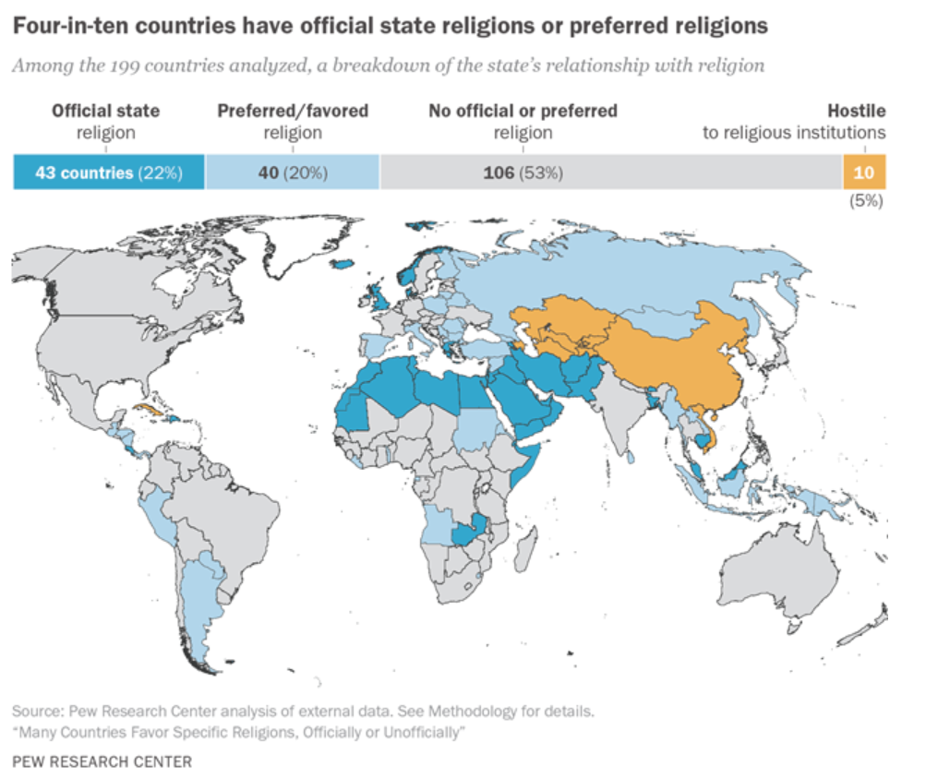
Pew Research Center, Many Countries Favor Specific Religions, Officially or Unofficially, October 2017
Notes:
Pew reports show that more than one in five countries (43) has an official state religion (the majority are Muslim) and a further 20% of countries have a favored religion. In 10 countries the state regulates religious institutions or is avowedly secular and is actively hostile to religion (eg China, North Korea, several former Soviet Republics).
Discuss how citizens in countries that have a ‘state religion’ ie the official religion of the country eg the UK (Queen is head of the Church of England) can be highly secular, and citizens in countries that have a clear separation of religion and state (USA) can be highly religious - the majority of Americans report that religion plays a ‘very important’ role in their lives. One main reason for this is that the First Amendment in the U.S. Bill or Rights grants freedom of religion without government interference.
Another example is France and its concept of Laicite - Secularism - a founding pillar of the French republic, also found in its First Amendment of the Constitution. In France, religion is a private matter and the State must be totally neutral regarding religion. https://www.youtube.com/watch?v=YIdBu-WmCsE

Slide 7
Laïcité

Slide 8
FoRB around the World - key facts
Government restrictions on religion around the world are reaching record-high levels (Pew Research Center, 2020)
At least 84 countries have laws against blasphemy and apostasy with sentences from fines to capital punishment (USCIRF Legislation Factsheet Blasphemy)
Oman, Mauritiana, Morocco and Brunei have increased the number of
blasphemy/apostasy laws in their respective countries (USCIRF Hearing on Blasphemy Laws and the Violation of International Religious Freedom, 2020)
COVID-19 has exacerbated FoRB violations (Religion News Service, 2021)
Since 2015, 9 countries have repealed blasphemy laws (USCIRF Hearing on Blasphemy Laws and the Violation of International Religious Freedom, 2020)
Notes:
*Record High Levels* -31/50 countries in Asia and the Pacific experienced government use of force related to religion (In 2017 it was 26/50 countries) -All but one country in MENA had reports of government use of force in relation to religion -40/48 countries in sub-Saharan Africa experienced government harassment of religious groups *84 Countries*
-Brunei, Iran, Pakistan and Mauritiana have death penalty for blasphemy -60+ countries list imprisonment as a sanction for blasphemy. This list includes Austria and Germany
*Repeal Laws* 9 countries that have repealed blasphemy laws since 2015 including Greece and New Zealand.

Slide 9
FoRB Violations
Actor | Example
State | Preferential treatment for majority religion to gain/maintain political support Discrimination entrenched in legislation and instutional practice, including legal practice,educational curricula etc
Individual/Community | Discrimination (economic exclusion, hate speech against other groups) Social constraints and limitations (eg social and family pressure against mixed-marriages, conversion/atheism)
Non state actor | Hate speech and incitement to violence from private media Attacks perpetrated by mobs, and/or violent extremist groups

Slide 10
FoRB Challenges
Perceived tensions between FoRB and other human rights
FoRB and children’s rights
Example: Circumcision as a religious imperative
FoRB and women’s rights
Example: Countries where family law is based on religious law, eg Sharia law regulating marriage/divorce
Dissonance between ratified international treaties, national legislation and practice on the ground
Focusing on FoRB violations in a specific location without situating them in the wider context of conflict and political dynamics, including general human rights violations.
1https://www.hrw.org/news/2021/01/18/sri-lanka-covid-19-forced-cremation-muslims-discriminatory

Slide 11
Common Ground Approach to FoRB
Collaboration
Collaborate with religious actors as key partners in advancing FoRB - not just victims or perpetrators
Find allies among both religious and non-religious actors: men, women, youth
Work with partners across government, civil society, academia, depending on the context
Audacity
Innovate to deliver FoRB outcomes - think out of the box when framing initiatives
Have those difficult conversations others shy away from
Find opportunities even in difficult contexts
Tenacity
Keep your focus on taking small steps forward to create long term sustainable change - even if it means ‘walking water’ for a time
Notes:
Search’s approach to advancing FoRB is rooted in finding the most common ground way of answering the needs and concerns of all parties while ensuring freedom for all
This includes impartiality. All sides have interests and needs. Discover them and work with them.

Slide 12
Common Ground Approach to FoRB
Empathy
Deeply understand the sensitivity of FoRB issues within the context
Engage with a diversity of perspectives, needs and motivations
Stay with dialogue as the basis for finding common ground
Remember you can still empathize with a perspective without agreeing
Results
Take a strategic and pragmatic approach - choose the issues that can deliver a measurable impact
Notes:
Search’s approach to advancing FoRB is rooted in finding the most common ground way of answering the needs and concerns of all parties while ensuring freedom for all
This includes impartiality. All sides have interests and needs. Discover them and work with them.

Slide 13
How does Search Advance FoRB?
How | Examples
Collaboration to secure legal/policy change | Hate speech, protecting holy sites Advocacy locally, nationally and internationally to policymakers
Building awareness/understanding | Communicating existing legislative framework, rights and responsibilities to local actors (police/judiciary) Interreligious dialogues and visits to religious communities Joint interreligious declarations that protect FoRB Building FoRB into educational curricula
Multi-religious and multi-sectoral approaches | FoRB roundtables Engaging actors across institutions - religions, academia, civil society, local government, judiciary, police Working with youth activists on FoRB media training to reduce online hate speech Early warning, early response systems

Slide 14
In light of what you have learned in this training, how would you seek to address FoRB violations and advocate respect for FoRB in your own country?

Slide 15
MODULE 9: KEY TAKEAWAYS
FoRB is a human right that protects people and communities of all religions and beliefs and of NO belief
Restrictions on FoRB are at an all-time high - aggravated by the rise of religious nationalism and the Coronavirus pandemic
FoRB violations can be perpetrated by the state, religious actors, institutions, and the general public and may be part of the day to day culture of a society
There may be tensions between FoRB and other human rights
Engaging religious actors is crucial to peacefully advancing FoRB
The Common Ground Approach provides a sustainable, locally owned and inclusive way of advancing FoRB

