Slide 1
ANO 502 EVALUATION SUMMARY
“Engaging Children and Youth as Partners in Preventing Violence against Children”
Waging Peace by helping young people become effective Peacebuilders

Slide 2
PROJECT OVERVIEW
Project Overview: “Engaging Children and Youth as Partners in Preventing Violence against Children” was a project funded by the European Commission intended to last 18-months with each of the three phases lasting six months.
Project Goal: The project aimed at “contributing to the eradication of all sorts of violence against children” in three border-sharing post-conflict countries of West Africa: Guinea, Liberia and Sierra Leone.

Slide 3
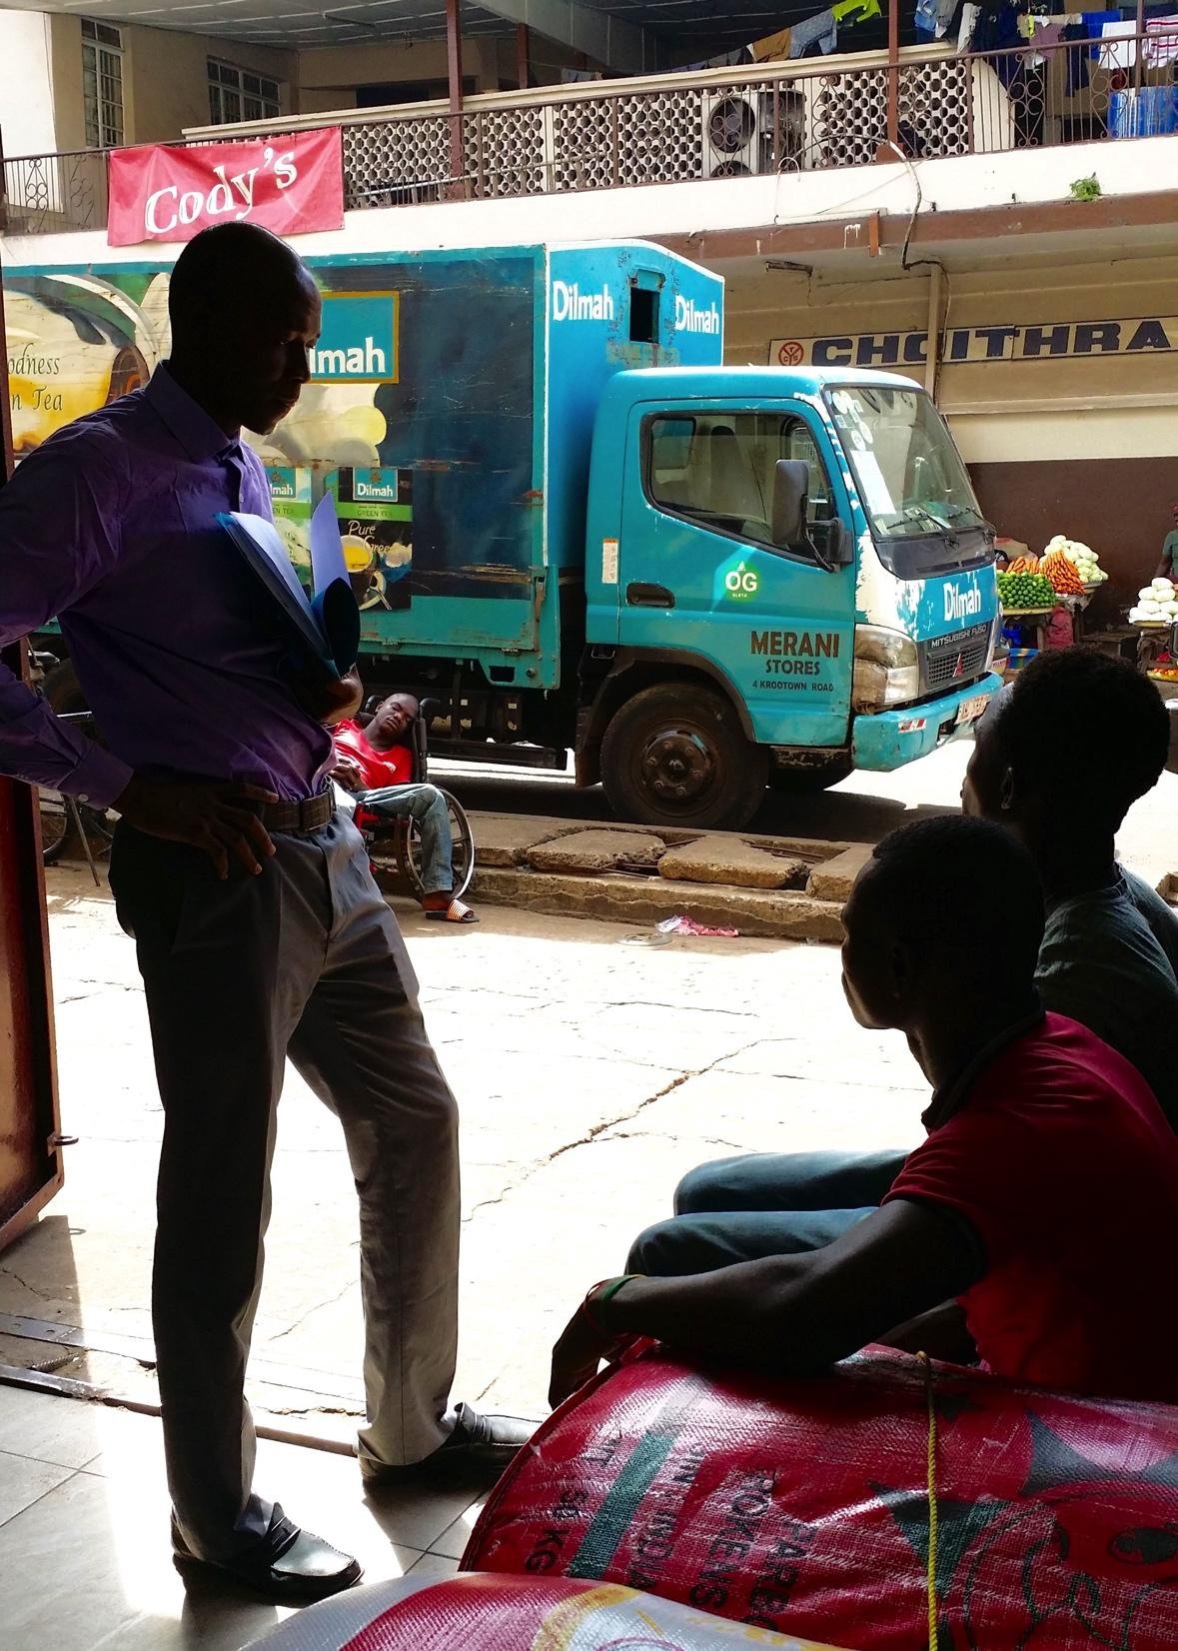
EVALUATION OVERVIEW
In Guinea, Sierra Leone and Liberia,
The evaluation included 114 participants
in interviews (79) or FGDs (35).
44 youth researchers were
involved in the evaluation along with
35 key stakeholders. This second
group comprised of SFCG staff, local
partners to the project,
representative of international and
national institutions and NGOs.
25 radio listeners were
interviewed despite challenges in
initially locating and inspiring them to
take part in the evaluation.

Slide 4
KEY FINDINGS
To what extent was the participation of youth beneficial and meaningful for them and for the project?
- One key success of this project has been the involvement of youth researchers (YRs).
Ensured the successful implementation of the project activities
Strong impact on the YRs themselves
YRs grew personally and professionally.
They provided credibility, commitment, perseverance, energy, compassion, and creativity that helped this project succeed despite many obstacles.
To what degree did the project vary in involvement and effects with regards to women vs. men/ girls vs. boys? ​
Male and female involvement in the project was similar
In Liberia, females were much less likely than were males to listen to the radio at all.

Slide 5
KEY FINDINGS
To what extent were the project activities implemented adequately?
Phase One of the project was successfully implemented in all three countries, Guinea, Sierra Leone and Liberia.
Due to implementation challenges, Phase Two and Three were less smoothly implemented; but were still effective despite taking place on a relatively smaller scale.
The project created strong resources to develop new strategies addressing the worst forms of violence against children and youth.
What is the level of usefulness of the 'Manuals on Prevention of Violence Against Children' and 'Research Reports on Worst form of Violence Against Children'?
Research Report was widely believed to have been very useful in all three countries.
Usefulness for education, inspiration, and providing a supportive evidence base was expressed by YRs and stakeholders alike.
Guiding Manual was only completed in Sierra Leone and was identified as useful by most stakeholders interviewed there as a tool to foster awareness and prevention.

Slide 6
KEY FINDINGS
Were the objectives and expected results adequately achieved? ​
The worst forms of violence against children were successfully identified and quality Research Reports were completed in all three countries despite delays due to multiple challenges.
Recommendations from children and youth were more successfully shared in Sierra Leone as the Guiding Manual was completed in that context. In all three countries, recommendations were shared with key stakeholders.
There was little to no evidence of changes in country level programmatic or policy actions related to children and youth. However, there was significant evidence of some project activities catalyzing significant community action projects to prevent violence against children.
There was limited evidence of having built the capacity of children and youth, beyond YRs, to advocate for their needs and prevent violence against their peers.

Slide 7
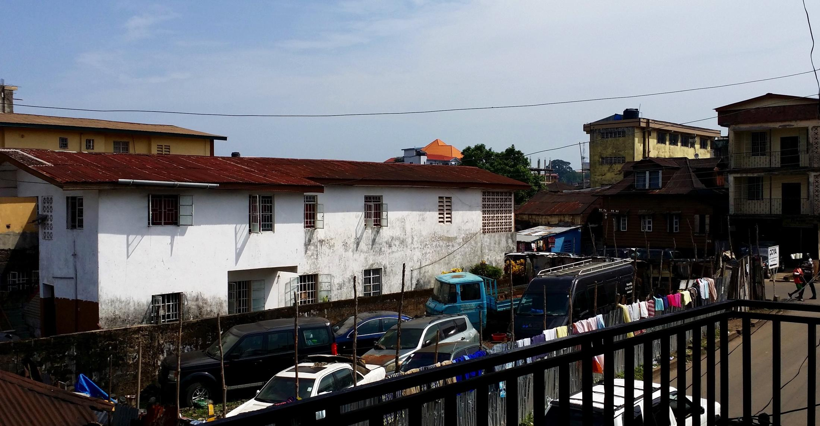
FACTORS HELPING AND HINDERING PROJECT’S SUCCESS
The following factors helped the project succeed:
Youth Researchers (YR) were key to the project’s success and were the most impacted by the project.
Many children and youth felt their voice was valued for the first time.
The project’s youth-led and participatory innovation drew attention from diverse stakeholders.
The following challenges
consistently influenced the
project’s success.
The project was shut down
during the height of the Ebola
crisis between August 2014
and March 2015.
Evaluation participants’
mentioned financial challenges as
the primary internal hindrance to
the project’s success.
Poor communication and
coordination hindered the project’s
success, particularly in phases
Two and Three.

Slide 8
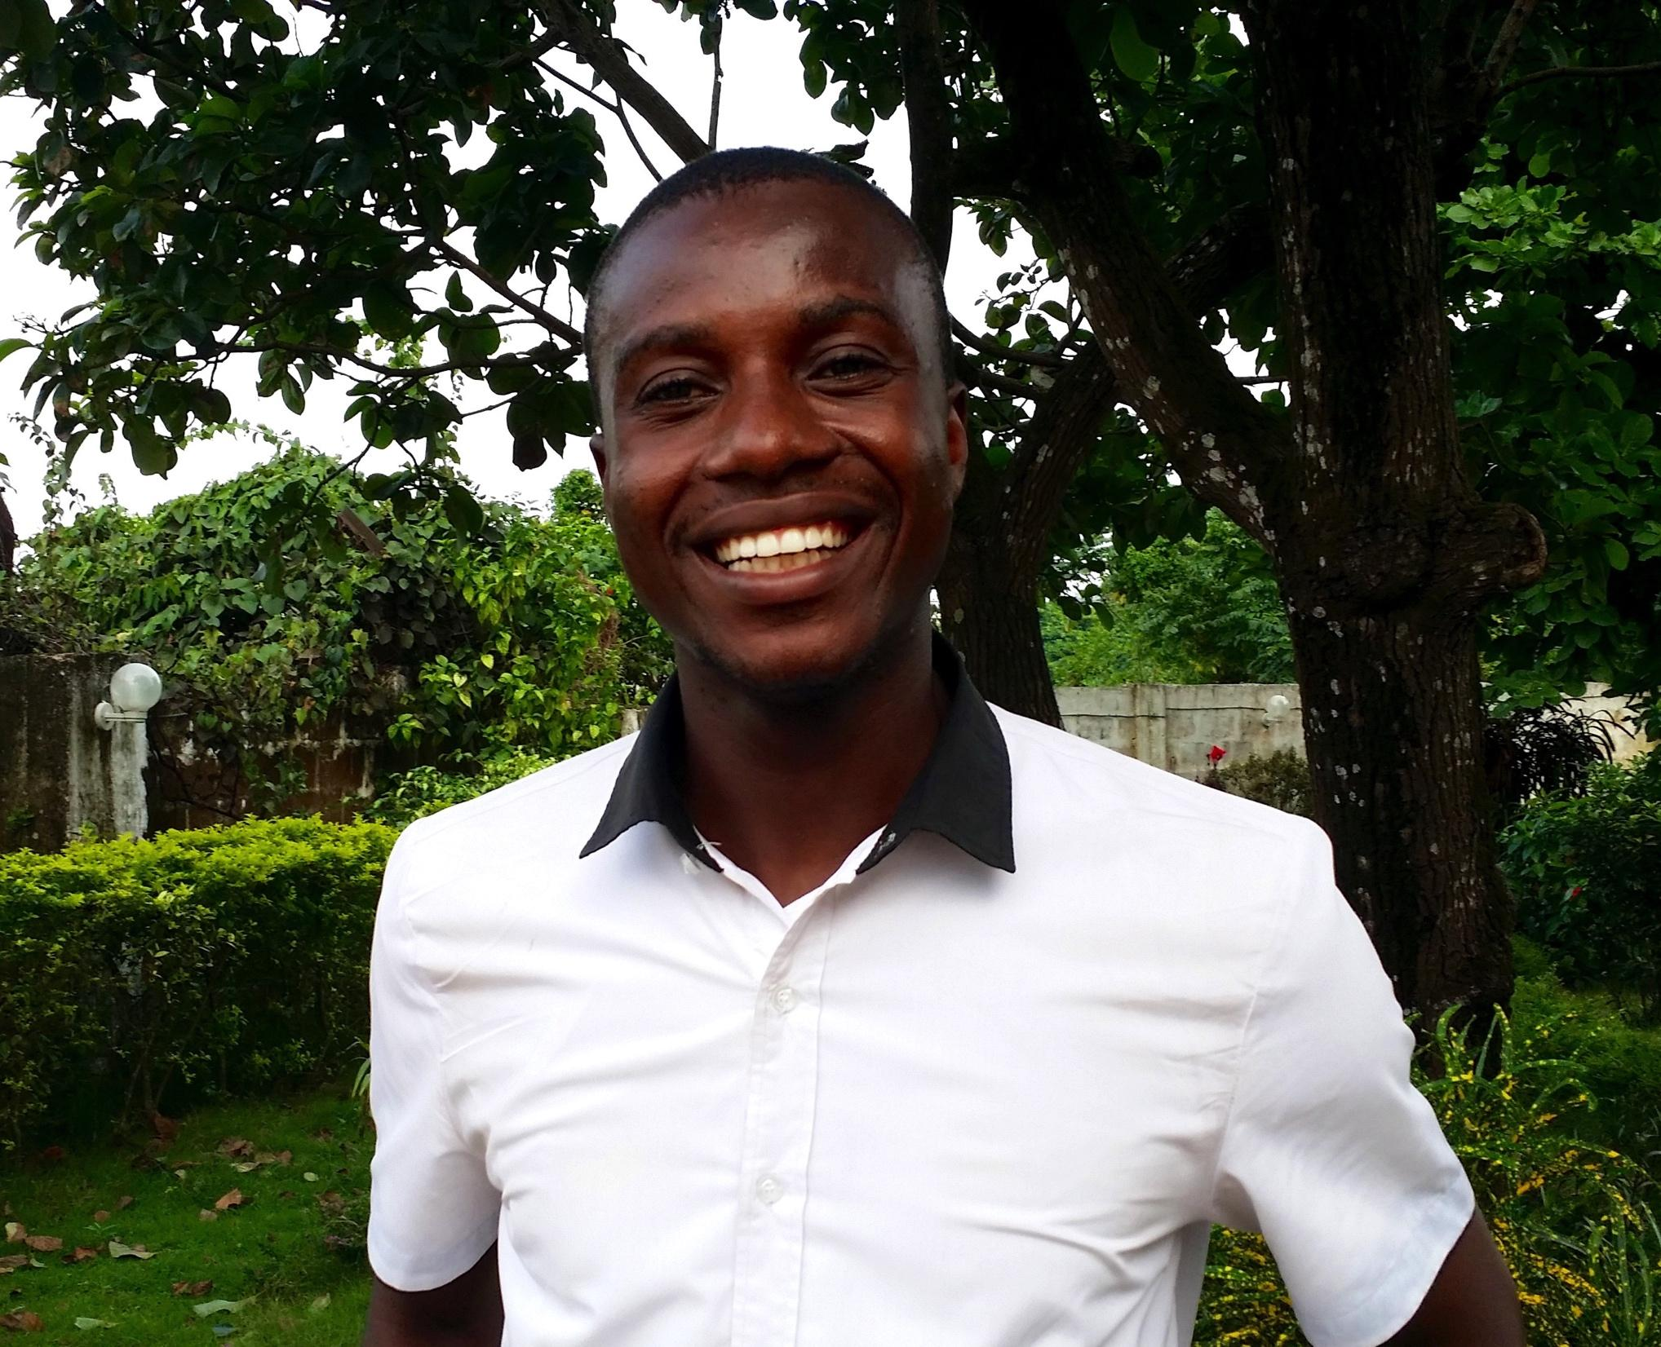
YOUTH RESEARCHERS RECOMMENDATIONS
Give symbolic rewards to YRs, like
certificates and physical reports, in
order to show appreciation.
Anticipate YRs wanting to volunteer
more of their time and energy.
Prepare an additional optional list of
meaningful peacebuilding activities
and challenges for YRs that require
minimal support from SFCG.
Develop a process within the project that allows the knowledge, experiences, and skills that YRs gain through their participation in the project to contribute the vision and objectives of SFCG in an ongoing way.

Slide 9
YOUTH RESEARCHERS RECOMMENDATIONS
YRs should be well prepared emotionally and psychologically before going to the field, while in the field, and after returning from the field. The potential risks of Vicarious Trauma and other harms should be assessed, identified, and addressed during the project design phase.
Ensure better preparation and coordination for responding to abuse disclosures during Phase One data gathering. For example, before conducting similar research, collaborate with other government agencies, NGOs, FBOs, and CBOs to prepare for likely referrals resulting from the research process. Prepare YRs to refer appropriately.

Slide 10
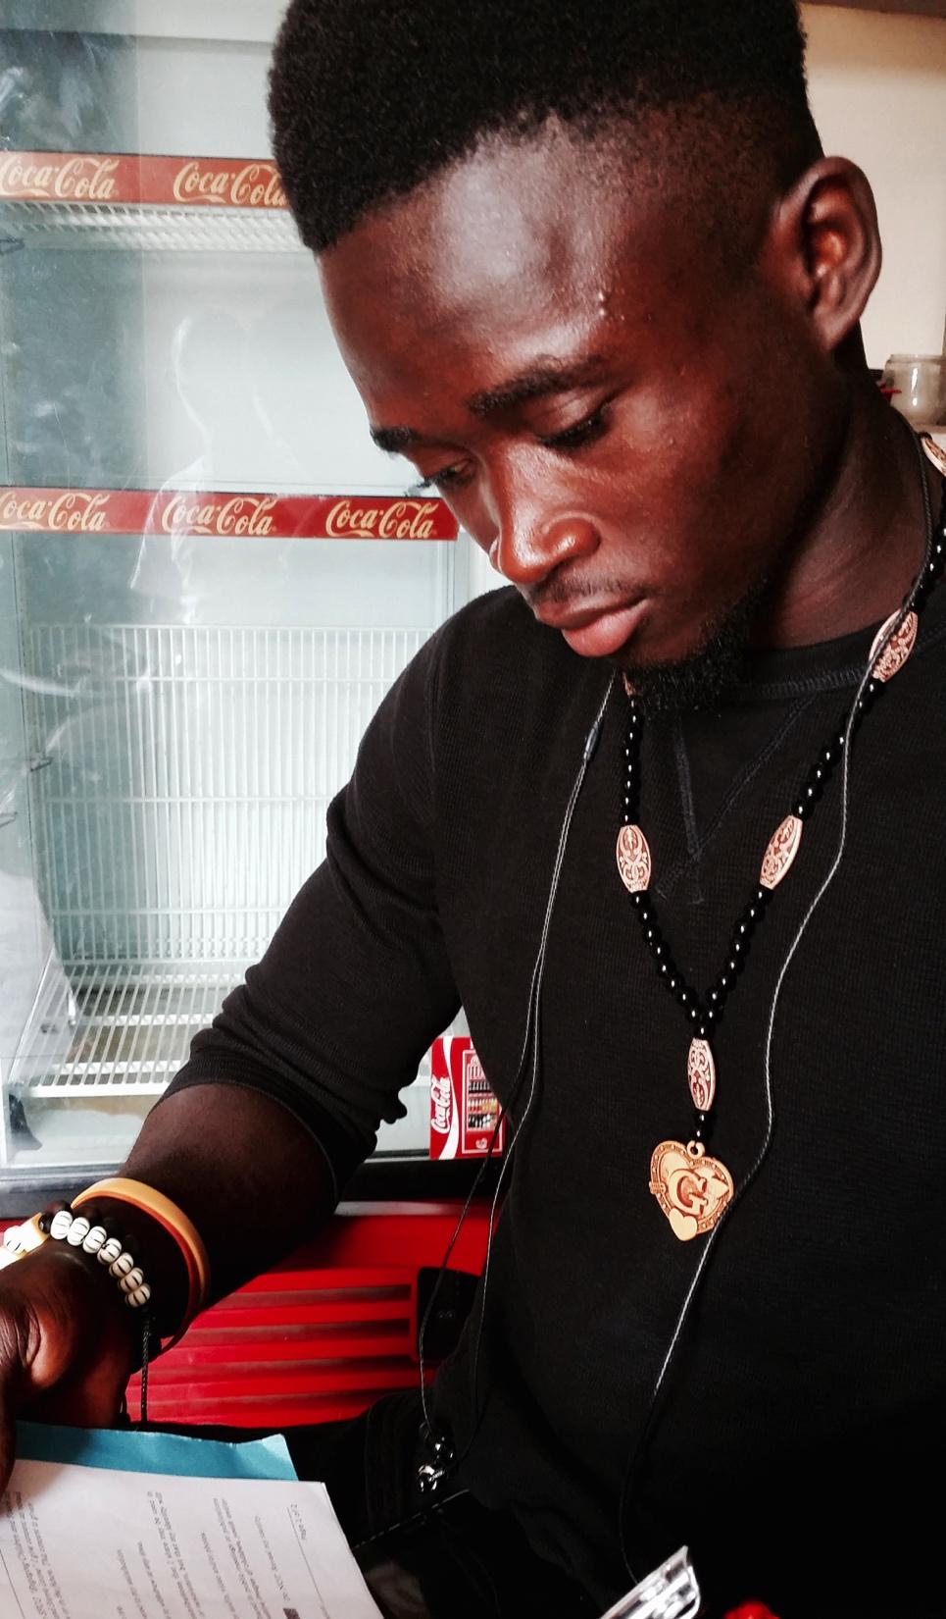
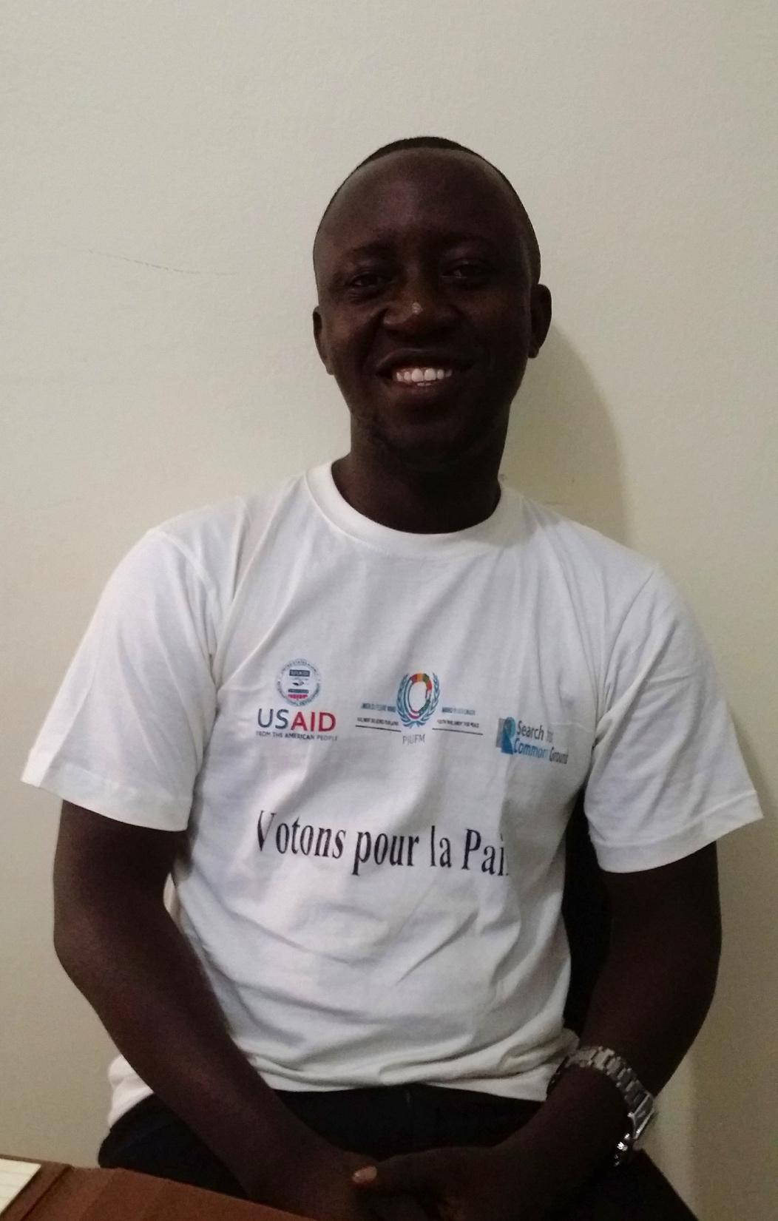
YOUTH RESEARCHERS RECOMMENDATIONS

Slide 11
KEY STAKEHOLDERS RECOMMENDATIONS
Increase the usefulness of Research Reports on Worst form of Violence Against Children by expanding awareness, distribution, and use.
Rely on the report for advocacy and policy-making as well as build upon the Guiding Manual for further awareness raising campaigns and projects.
Hire a staff dedicated to this project in each country to better address communication and coordination challenges, in case of future similar cross-border project including various countries.

Slide 12
MEDIA-RELATED RECOMMENDATIONS
Create additional radio shows and increase coverage and interactive opportunities to better leverage the potential impact of the Research Reports and Guiding Manuals.
Expand further participatory community theater activities in all three countries based on materials and project activities developed through this program.
The reach and resonance can be increased through expanding the number of participants or locations visited.

Slide 13
OTHER COMMUNITY MEMBERS
Work toward consistent follow up with and meaningful inclusion of all involved in the research. During the research phase these young people could be given low-cost tools for ongoing participation in the process.
Providing research participants with updates on the report, actions taken post research, and so forth, could also assist with diminishing effects of potential retraumatization experienced by participants from disclosing violence and and abuse they experienced while receiving limited support.

